Slide 1
Project Title : Sociogram (Web Application)
Team Name : Code6

Slide 2
Team Members List
Team Members | Responsibilities
1) Venkata Rajashekar Reddy Chinthala | UI Design
2) Raja Srinivas Nelluri | UI Design
3) Satish Thammaneni | Frontend Development
4) Sai Karthik Koncherlakota | Testing
5) Sathwik Gaddi | Backend Development
6) Sri Snigdha Kotharu | Database Handling
7) Tanvi Thirunathan | Backend Development
8) Putta Ramya Priya | Backend Development

Slide 3
Overview
Sociogram is an online web application that helps people to
Connect around the globe via messaging/audio call.
Find new people with similar hobbies/interests.
Book tickets to events and movies nearby.
Use discussion forums to share thoughts/ideas.

Slide 4
Core Functionalities
Personalized user profile.
Find people with similar interests/hobbies.
Connect/collaborate via messaging and audio calling
Share media/articles/ideologies.
Add privacy settings to each of the uploaded posts.

Slide 5
Core Functionalities
Use discussion forums to raise queries, participate in debates etc..
Explore/book tickets for ongoing/upcoming events.
Get reminders for booked tickets/events.

Slide 6
Development Environment
UI Design and Development
Languages Used:
HTML, CSS, Bootstrap, JavaScript, SaaS.
Platform Used:
Visual Studio Code
Backend Development
Languages Used:
NodeJs
Platform Used:
Visual Studio Code

Slide 7
Development Environment
Database Used: MongoDB
Project Management Tool: Trello
Configuration Management System: GitHub

Slide 8
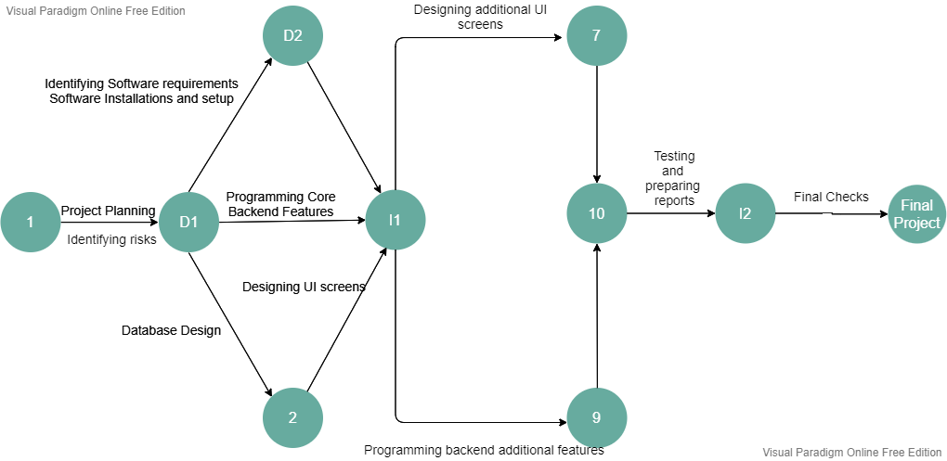
Pert Chart

Slide 9
Risks
Timelines Risk
Communication Risk
Merge Conflicts Risk

Slide 10
Thank you For your attention.

